Slide 1
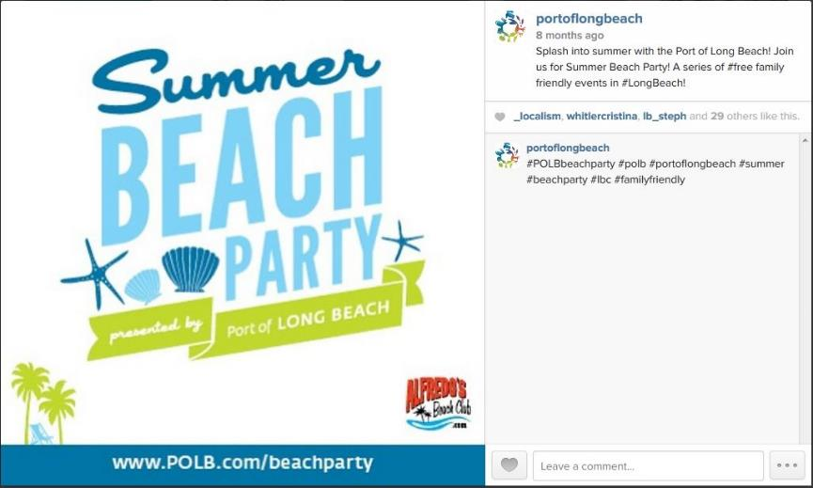
Port of Long Beach
Summer Beach Party Social Media
Social/Web-based Media

